Slide 1
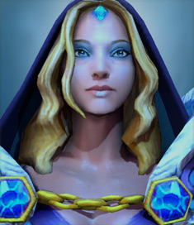


Slide 2
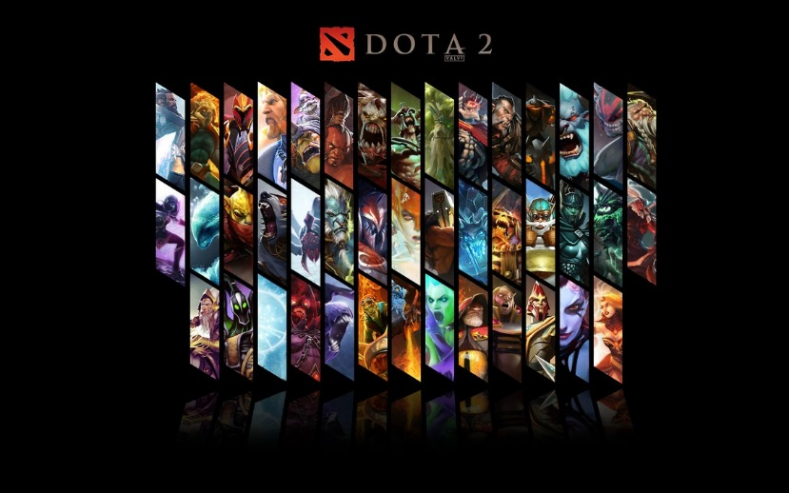
Who’s Winning? a predictor of DOTA 2
Proposed by:
Zheng Da Ye Qiaomin
Jiao Enwei Liao Ruochen
Chen Xin

Slide 3


What is DOTA 2?
Two teams, the Radiant and the Dire, both containing 5 players
There are around 100 "Heroes" in Dota 2
Heroes are strategically powerful player-controlled units with unique special abilities
Composition of the team can significantly affect their performance throughout the match

Slide 4



What can we do other than play?
Which team makes stronger?
Input: 10 heroes picked
Output: match result

Slide 5

How can you do that?
DOTA2 opened its matches history to public
We gathered some of them for you(1 million games)
You can find quite a lot info from the dataset and extract features as you wish

Slide 6
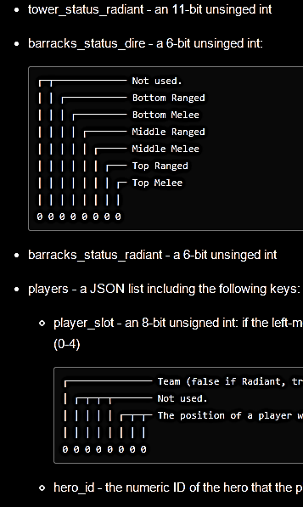
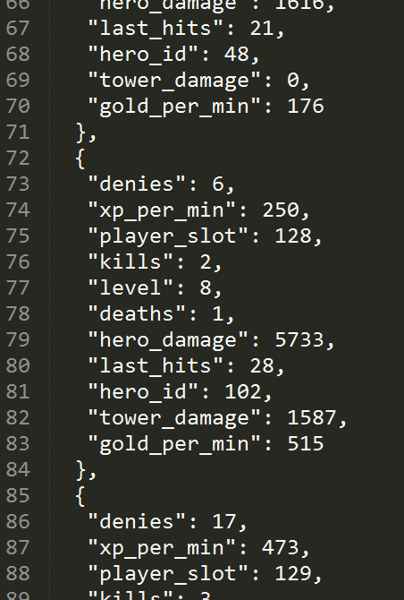
What we have prepared for you!
Three data sets with 10K, 100K and 1M all-human matches in them
Abandoned games are filtered out
One-key-to-run baseline program and helpful tools
Detailed project/data description

